Slide 1
AGILE methodology

Slide 2
What is agile
Agile is a project management and software development approach that aims to be more effective.
It focuses on delivering smaller pieces of work regularly instead of one big launch.
This allows teams to adapt to changes quickly and provide customer value faster.
What is Agile Methodology?
Agile methodologies are iterative and incremental, which means it’s known for breaking a project into smaller parts and adjusting to changing requirements.
They prioritize flexibility, collaboration, and customer satisfaction.
Major companies like Facebook, Google, and Amazon use Agile because of its adaptability and customer-focused approach.

Slide 3
Types of agile framework
Agile frameworks are methods of organizing and dealing with software program development initiatives that follow the principles and values of the Agile Manifesto. Agile frameworks intend to supply value to clients faster and extra often, even also allowing groups to conform to converting requirements and remarks.
Types of Agile Frameworks
Kanban
Scrum
Lean
DSDM or Dynamic Systems Development Method ·
XP or Extreme Programming
FDD or Feature Driven Development
Crystal
Scaled Agile Framework (SAFe)

Slide 4
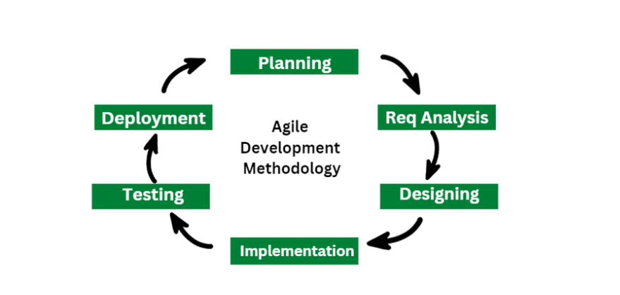
Agile methodology lifecycle

Slide 5
When to use agile
It is particularly well-suited for projects and organizations where the following conditions or needs are present:
Unclear or Changing Requirements: Agile is great for projects with requirements that aren’t well-defined or might change.
Complex Projects: It’s good for big, complex projects by breaking them into smaller pieces.
Customer Focus: Use Agile when making customers happy is a priority and you want to involve them throughout.
Quick Time-to-Market: If you need to get your product out fast, Agile can help.
Small to Medium Teams: Agile works well for teams of a few to a few dozen people.
Team Skills: It’s best when you have a mix of skills in your team, like development, testing, design, and more.
Collaboration: Agile promotes working together and open communication.

Slide 6
Benefits of agile
Immediate Feedback: It allows immediate feedback, which aids software improvement in the next increment.
Adapts to Changing Requirements: It is a highly adaptable methodology in which rapidly changing requirements, allowing responsive adjustments.
Face-to-Face Communication: Agile methodology encourages effective face-to-face communication.
Time-Efficient: It is well-suited for its time-efficient practices, which help in delivering software quickly and reducing time-to-market.
Frequent Changes: It effectively manages and accommodates frequent changes in project requirements according to stakeholder convenience.

Slide 7
What is scrum
Scrum is an agile project management framework that helps teams structure and manage their work through a set of values, principles, and practices. Much like a rugby team (where it gets its name) training for the big game, scrum encourages teams to learn through experiences, self-organize while working on a problem, and reflect on their wins and losses to continuously improve.
Most Scrum projects borrow the “XP” (Extreme Programming) practice of describing a feature request as a “User Story,” although a minority uses the older concept of a “Use Case

Slide 8
Scrum members
Development team
A development team is a group of people that collaborate to create and execute required and promised production milestones. It is made up of personnel from several departments who can successfully complete the cycle's objectives. This implies that people of the development team can indeed be computing scientists, artists, editors, financial analysts, and every other job that is required to meet the cycle's objectives.
Product Owner
By discovering features of the product, turning them into a prioritised list, choosing which must be at the number one spot for the next cycle, and constantly redefining priorities and polishing up the list, the product owner is liable for optimising return on the investments. If the commodity is a business one, the product owner is responsible for its income statement. During the cycle, the product owner acts as a consumer spokesman and ought to speak for them.

Slide 9
Members of scrum team
Scrum Master
The Scrum Master assists the product team in learning and implementing Scrum to generate a value proposition. The Scrum Master undertakes all in their ability to ensure the effectiveness of the team, product owner, as well as company. The Scrum Master is really not a project coordinator, program manager, team spokesperson, or team captain. Instead, the Scrum Master assists the team by assisting in the removal of roadblocks, protecting the team from external influence, and assisting the team in the adoption of modern development principles.

Slide 10
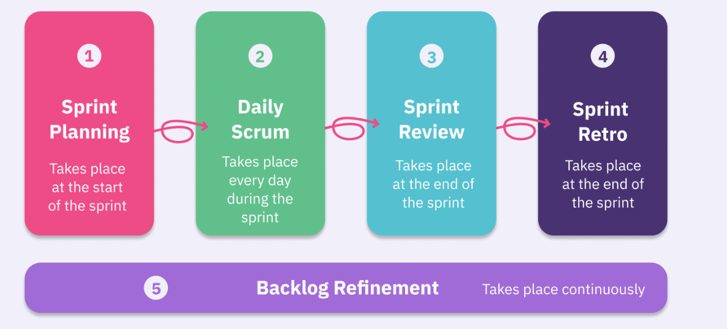
Scrum ceremonies

Slide 11
Scrum ceremonies
Sprint Planning
This ceremony helps to set up the entire team for the coming sprint, creating a smooth pathway for a successful sprint. Sprint planning requires the participation of all the scrum roles: the development team, scrum master and the product owner. The planning, of course, is prior to the sprint. It typically lasts for an hour or two.
The product owner comes to the meeting with a prioritized list of the product backlog items, which is presented to the group. The items on the list, which are also called user stories, are then discussed with the development team. Together, they estimate what it will take to complete the items on the list. From this information, the development team makes a sprint forecast

Slide 12
Daily scrum call
The Daily Scrum is a short, daily ceremony that helps team members share progress, unblock each other, and sync-up on work. Because it brings the whole team together every day, you can share and remove obstacles quickly so everyone can continue in flow toward the Sprint Goal.
During the Daily Scrum, every developer typically answers some version of these three standup questions:
✅ What did you do yesterday?
‍💡 What will you do today?
⛔ Is anything blocking your progress?

Slide 13
Sprint review
The purpose of the Sprint Review is to inspect the outcome of the sprint and determine future adaptations. The Scrum team presents the results of their work to key stakeholders, and progress toward the Product Goal.
During the Sprint Review, the Scrum team shows what they accomplished during the sprint to get feedback from project stakeholders. You’ll determine if you met the Sprint Goal you set in the Sprint Planning meeting and discuss how to improve the product further in future sprints. By the time the Sprint Review comes around, teams should have a working piece of software or product to show off. That’s why the Sprint Review is also sometimes known as the Sprint Demo.

Slide 14
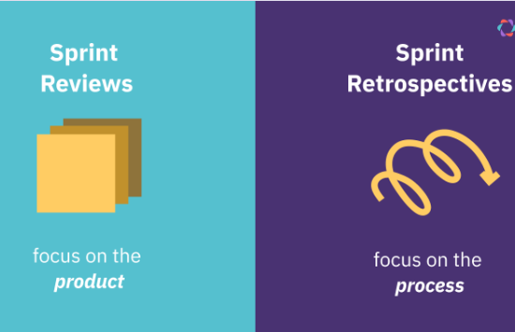
SPRINT retrospective
The Sprint Retrospective helps teams build a habit of continuous process improvement. During this ceremony, the Scrum team figures out what they can improve by inspecting how the last sprint went. Individuals, interactions, processes, tools – anything is up for review and discussion. Also, take time to celebrate what went well – give kudos to a colleague, and discuss how to replicate successes in the future. Like the Sprint Review, it takes place at the end of the Sprint, but its focus is on processes, not the product.

Slide 15
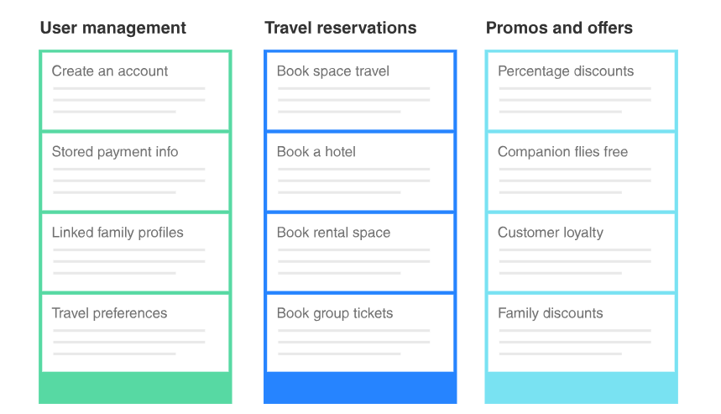
Terminologies in scrum
Product Backlog
A product backlog is a prioritized list of work for the development team that is derived from the product roadmap and its requirements. The most important items are shown at the top of the product backlog so the team knows what to deliver first. The development team doesn't work through the backlog at the product owner's pace and the product owner isn't pushing work to the development team.

Slide 16
Terminologies in scrum
Sprint Backlog
A sprint backlog keeps a team focused during their Scrum sprints, which refers to the period of time allotted to complete work. It’s a task list a team works from during the sprint that helps prevent scope creep. That’s because they allow you to prioritize which tasks to pursue.
The sprint backlog is a short-term plan to accomplish a series of tasks within a sprint. The team cannot alter it during a sprint.

Slide 17
Terminologies in sprint
Sprint Velocity
Sprint velocity serves as an Agile metric for estimating the amount of work a Scrum team can complete within a given time frame—typically a single sprint.
You can express velocity in story points, a unit of measure for sizing user stories or tasks in terms of complexity, risk, and uncertainty. Story points provide a more nuanced way to estimate work than time-based metrics, such as hours or days.
SprintBurndown
A burndown chart shows the amount of work that has been completed in an epic or sprint, and the total work remaining. Burndown charts are used to predict your team's likelihood of completing their work in the time available. They're also great for keeping the team aware of any scope creep that occurs.

Slide 18
Terminologies in sprint
Backlog Refinement
Backlog refinement (formerly known as backlog grooming) is when the product owner and some, or all, of the rest of the team, review items on the backlog to ensure the backlog contains the appropriate items, that they are prioritized, and that the items at the top of the backlog are ready for delivery.

